Slide 1


Slide 2
Definition
Goldberg, 1989: “Genetic Algorithms are search algorithms based on the mechanics of natural selection and natural genetics.”
A genetic algorithms is a directed random search procedure
A genetic algorithm borrows ideas from
biology to search a solution space for a
target value.

Slide 3
General Approach
4
3
Random Mating
Random Selection
1
Selection
Parents
Random
Population of Solutions
Population
5
Crossover
Mutation
Random
Mutation
2
Evaluate
Offspring
Replacement
6
New Population

Slide 4
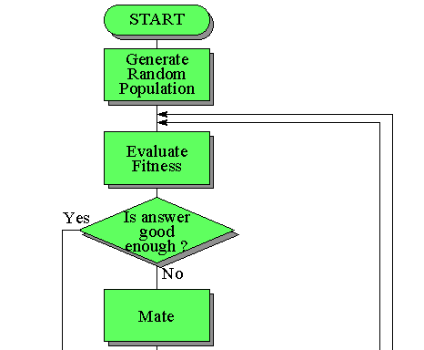
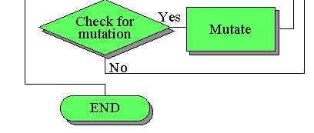
GA Flow Chart

Slide 5
Parent Selection
The process in which individual strings in the population are selected to contribute to the next generation is called parent selection
based on fitness
strings with a high fitness have a higher probability of contributing one or more offspring to the next generation
Biased Roulette Wheel Selection
When you spin the wheel,
items 1 and 5 have the
greatest chance of coming up
while item 2 has the smallest
6
4
1
3
2
5

Slide 6
Example
Given the following population of chromosomes, select two parents:
Chromosome Fitness
% fitness
cf
(1 0 1 0 0 1) 23
0.28
0.28
(1 1 1 0 0 1) 12
0.15
0.43
(0 1 1 0 1 1) 25
0.30
0.73
(0 1 0 1 1 0) 5
0.06
0.79
(0 1 1 0 1 0) 17
0.21
1.00
Total Fitness 82
Find the total fitness of the population
Now, throw a random number between 0 and 1, if it is
in the range 0 to 0.28 select element 1, between 0.28 and 0.43
select element 2, . . .
Find the %fitness of each element
Find the cumulative fitness

Slide 7
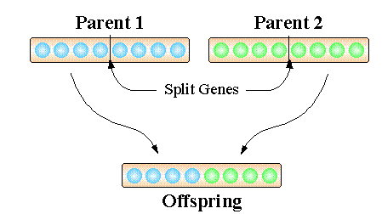
Crossover
Once two parents are selected, their chromosomes are mixed to create the children for the next generation
Called single point crossover

Slide 8
Example
Assume the parents selected from the previous example are:
(1 0 1 0 0 1) (0 1 1 0 1 0)
(1 0 1 0
1 0)
(0 1 1 0
0 1 )
These are the two children which
are now part of the next generation
Find a random crossover point
Swap the bits after the crossover point

Slide 9
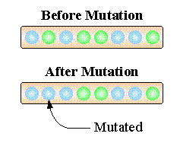
Mutation
A bit in a child is changed (from 1 to 0 or from 0 to 1) at random
This is a small probability event
The effect is to prevent a premature convergence
to a local minimum or maximum

Slide 10
GA Performance
Increasing diversity by genetic operators
mutation
Recombination
Decreasing diversity by selection
of parents
of survivors

Slide 11
Effects of the Genetic Operators
Using selection alone will tend to fill the population with copies of the best individual from the initial population
Using selection and crossover will tend to cause the algorithm to converge on a good but sub-optimal solution
Using mutation alone induces a random walk through the search space
Using selection and mutation creates a parallel, noise-tolerant, hill climbing algorithm

Slide 12
The Algorithm
randomly initialize population(t)
determine fitness of population(t)
repeat
select parents from population(t)
perform crossover on parents creating population(t+1)
perform mutation on population(t+1)
determine fitness of population(t+1)
until best individual is good enough

Slide 13
GA Applications
GA’s can be applied to several parts of the physical design problem
Partitioning
Placement
Other . . .
Scope of the Partitioning problem
A standard layout benchmark suite has circuits ranging from 13,000 to 200,000 nodes.
The number of links range from 50,000 to 800,000

Slide 14
Representation
A graph partition is represented by a binary string
Each node is represented by a bit
The 0 nodes are in one segment, the
1 nodes are in the other segment
1
6
5
2
(0 0 0 1 1 1)
3
4

Slide 15
Population
A random population of binary strings is produced
(0 0 0 1 1 1)
4
1
6
(1 0 0 1 0 1)
4
5
2
3
4
(1 0 1 1 0 0)
5
(1 0 0 1 1 0)
4
The fitness is the number
of links

Slide 16
Crossover
Parents are randomly selected (with a bias to the better fit elements)
The parents are combined to create two children (single point crossover)
(0 1 0 1 0 1)
(1 1 0 1 0 1)
(0 0 0 1 0 1)
(1 0 0 1 0 1)

Slide 17
Mutation
For a small number of the new population elements perform a mutation operation
Randomly select two nodes and swap their positions

Slide 18
Thank you

